Slide 1
Named Entity Recognition Tagging
Group Tag-Alongs
Divya Pattisapu, Premkumar Reddy, Sanat Bhargava, Varnika Vatsyayan

Slide 2
Problem statement
What is NER?
Why we need NER?
WIESP data set

Slide 3
Objective
IOB tagging format[1] (Inside, outside, beginning)
I- prefix - tag is inside a chunk
B- prefix - tag is the beginning of a chunk that immediately follows another chunk without O tags between them
O tag - token belongs to no chunk
Input: Words
Output: NER tags
Austin
B-Person
Examples from WIESP2022 dataset:
Word: NASA NER Tag: B-Organization
Word: NNX13AP13G. NER Tag: B-Grant
General Examples
Alex I-PER, going O, Los I-LOC
Angeles I-LOC, California B-LOC
Hoag
I-Person
Train model to predict NER tokens
X: Input sentences
Tokenize and padding
Train test split
Y: Output NER tags
Map to indices and one-hot encoding
Train test split
Source
[1] https://en.wikipedia.org/wiki/Inside%E2%80%93outside%E2%80%93beginning_(tagging)#:~:text=The%20IOB%20format%20(short%20for,named%2Dentity%20recognition).

Slide 4
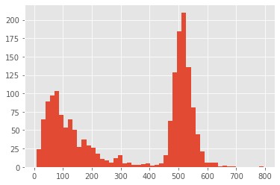
Data preprocessing
list of tuples
sentence lengths
create word-to-index and index-to-word
Padding
Train_Test split
GLOVE embedding

Slide 5
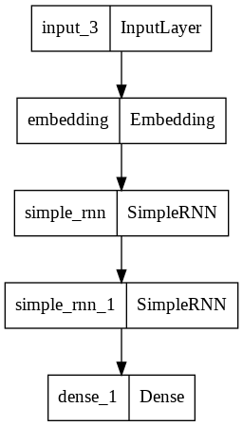
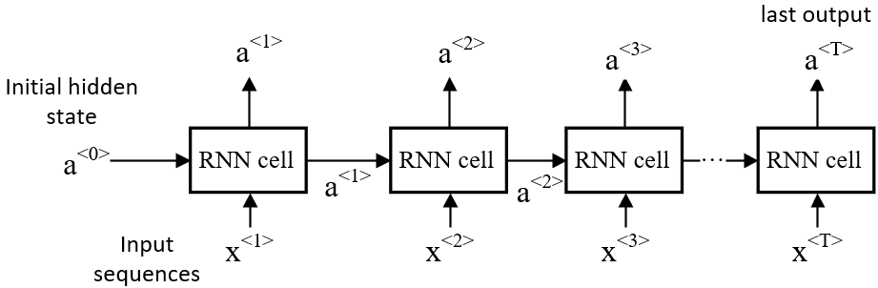
Model 1 (Base model):
Training
Training accuracy | 97.9%
Validation accuracy | 96.4%
Glove embedding
Initialized using embedding matrix created from train vocabulary.
RNN Prediction
Hoag et al. | B-Citation I-Citation I-Citation | Correct
Harvard | B-Organization | Correct
HST-HF2-51413.001-A | B-Person | Incorrect
Peirce Fellowship | B-Person B-Fellowship | Incorrect
Figure 2: Simple RNN model example image[1]
Figure 1: Model architeture
Source
[1] https://www.dlology.com/blog/how-to-use-return_state-or-return_sequences-in-keras/

Slide 6
Model 2: Bi-Directional LSTM
As before, we merge individual tokens corresponding to the unique IDs to form sentences.
The only difference this time around is that we utilize the Bidirectional variant of the Long-Short Term Memory model instead of a vanilla RNN with the goal of capturing richer context from the sentences. The reasoning behind this is that looking at a sentence from both directions allows us to capture richer past and future context that can prove to be crucial to label complex entities in a sentence.
Since we had an appreciable performance with a two-layered base model, we create our model with two layers of BiLSTMs. Adding more layers would add unnecessary complexity in the model without a proportionate improvement in performance.

Slide 7
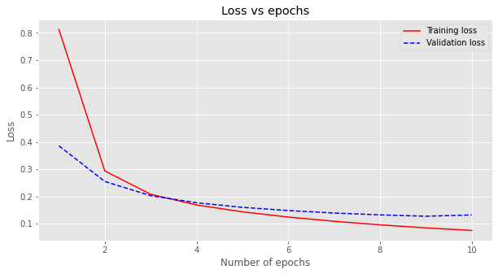
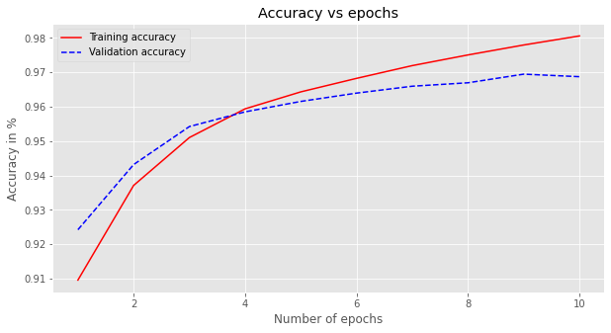
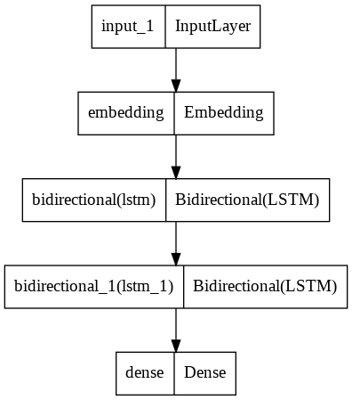
Model Architecture and Performance
Hoag et al. | B-Citation I-Citation I-Citation | Correct
Harvard | B-Organization | Correct
HST-HF2-51413.001-A | B-Person | Incorrect
Peirce Fellowship | B-Fellowship I-Fellowship | Correct
Training accuracy | 98.04%
Validation accuracy | 96.87%

Slide 8
Future Work
To further improve performance of the BiLSTM model we could input the logits obtained from the BiLSTM model to a Conditional Random Field (CRF).
The CRF allows us to capture the relationship between the labels of two successive entities, much like a Hidden Markov Model (the current state is dependent on the predecessor state).
Eg: If we have the label “B-Citation”, using a CRF will allow us to predict the label of the next entity as “I-Citation” with great likelihood.

Slide 9
Concluding Remarks
In this project we develop a model that effectively tags the text fragments from an astrophysics dataset.
We see that our model architecture outperforms the base model.
The reason is that BiLSTMs capture more context.
Example: For words like Ashford fellowship, the second word indicates that it is a fellowship. In our first model, where we only used forward RNNs we lost that context and tagged it incorrectly as O. In using the BiLSTMs, we were able to tag is as a fellowship.

